Slide 1
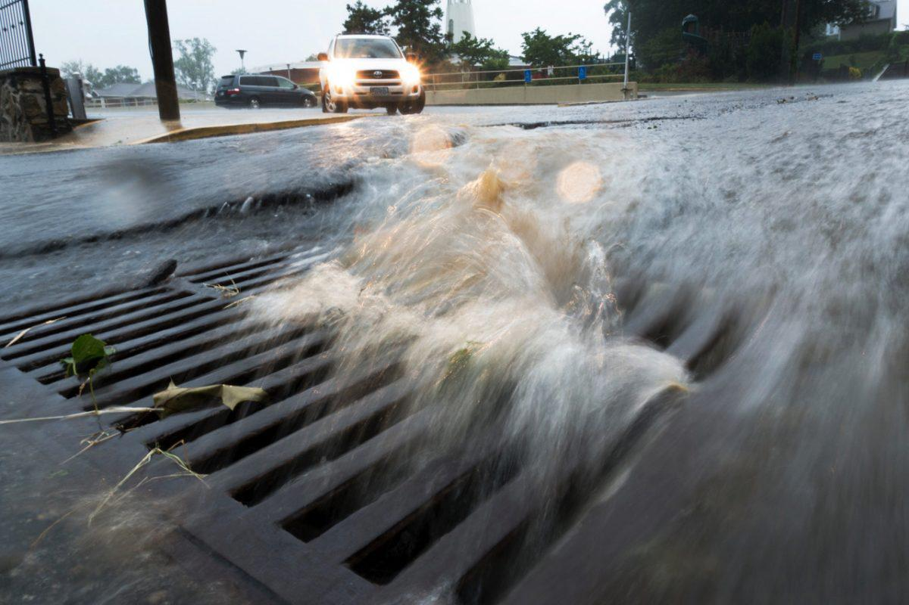
2021 Year-in-Review
Presented at the
BASWG Annual Meeting
February 10, 2022
Virtual Meeting via Zoom

Slide 2
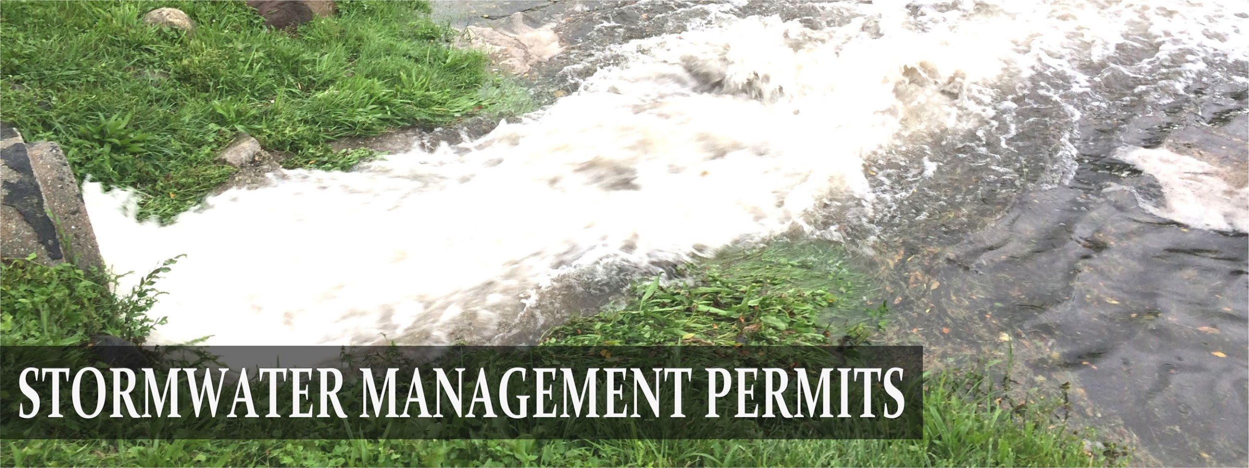
What Does the BASWG do?
Assist MS4s with MS4 permit regulatory compliance
Focus on E&O, but assist with other MCMs
Able to discuss emerging issues, brainstorm, troubleshoot
Allow all MS4s to meet together with DEP staff
Provide a stronger voice
Enables economies of scale
Secure external grant funding for “above and beyond” efforts
Minimum Control Measures (MCMs):
Public outreach and education
Public involvement
Illicit Discharge Detection and Elimination
Construction
Post-Construction
Good Housekeeping and Pollution Prevention

Slide 3
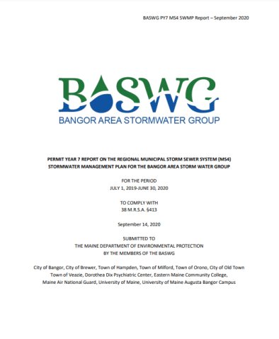
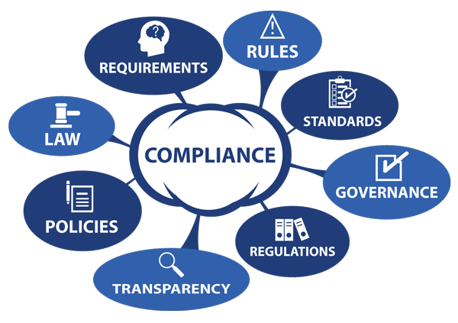
Ensuring Permit Compliance: BMP1A. Public Awareness
Continuation of Permit in PY8 (2020-2021) Submitted annual report September 2021
Maintaining a consistently active BASWG Facebook page with 3 posts per week.
Making 1-3 of these weekly posts "boosted posts," which helped to expand the reach of social posts beyond their organic audience.
Continuing to provide an active BASWG presence on both Instagram and Twitter.
Maintaining the BASWG website.
Running public outreach events → Ad display campaigns
Stormdrain stenciling in MS4 Communities
Continued distribution of lawncare materials
Implementation of Regional Supplemental Social Media Plan
Online Winter Outreach Campaign
BMP1A. Targeted BMP Adoption

Slide 4
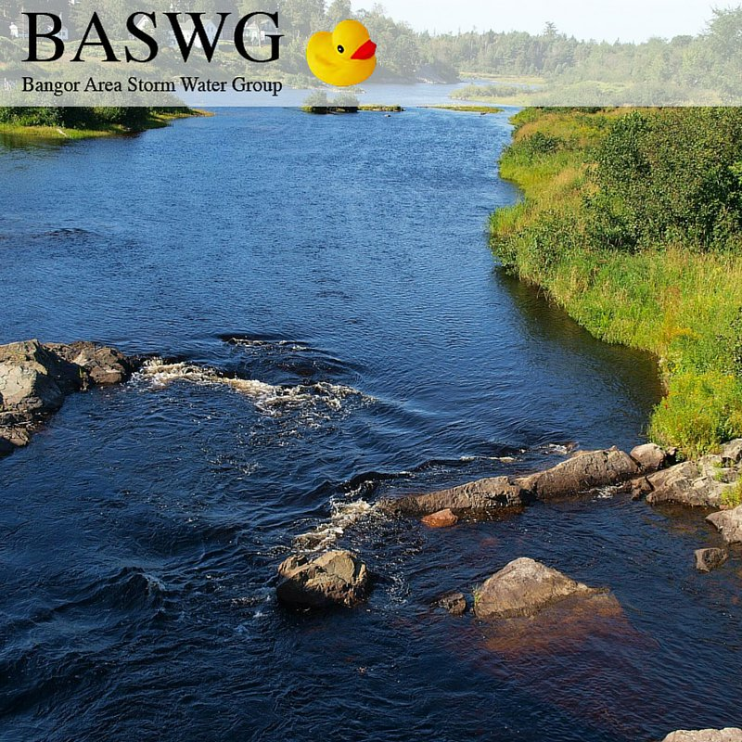
Continued Focus on:
Compliance
Minimum Requirements
Any additional – external funds
BASWG PY8 Budget | 2020-2021
Regional Coordination | $ 13,750
Website Hosting/Domain Name | $ 100
Legal Form Fees | $ 200
Grant Writing | $ 1,000
Statewide Salt Collaboration | $ 1,000
Education and Outreach | $ 22,350
Total BASWG Budget | $ 38,400

Slide 5
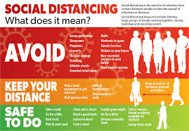
MCM 1: Education & Outreach MCM 2: Public Involvement
Hoped to deliver in PY8, but cont. restrictions
Canceled
Maine Science Festival
Opportunistic
Street and Stream Clean-ups ←
Stormdrain marking
Continuing New Sources of Pollution
Opportunity for PPE Campaign
Leverage success of online campaigns
Broader, but less personal, reach

Slide 6
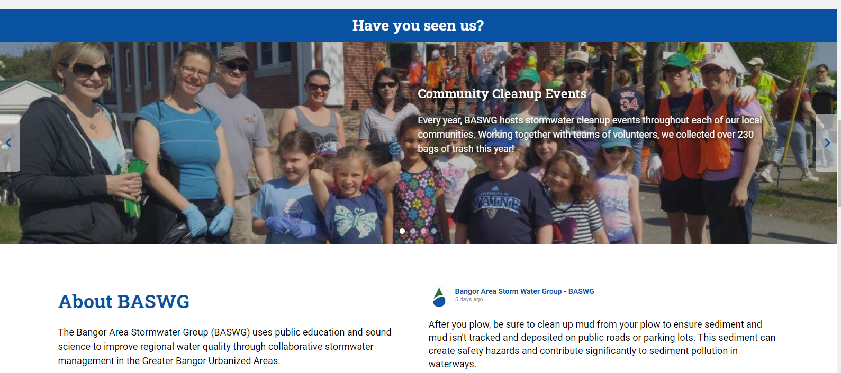
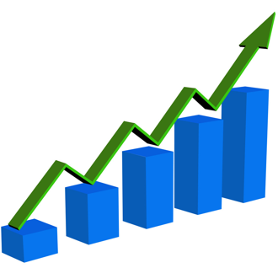
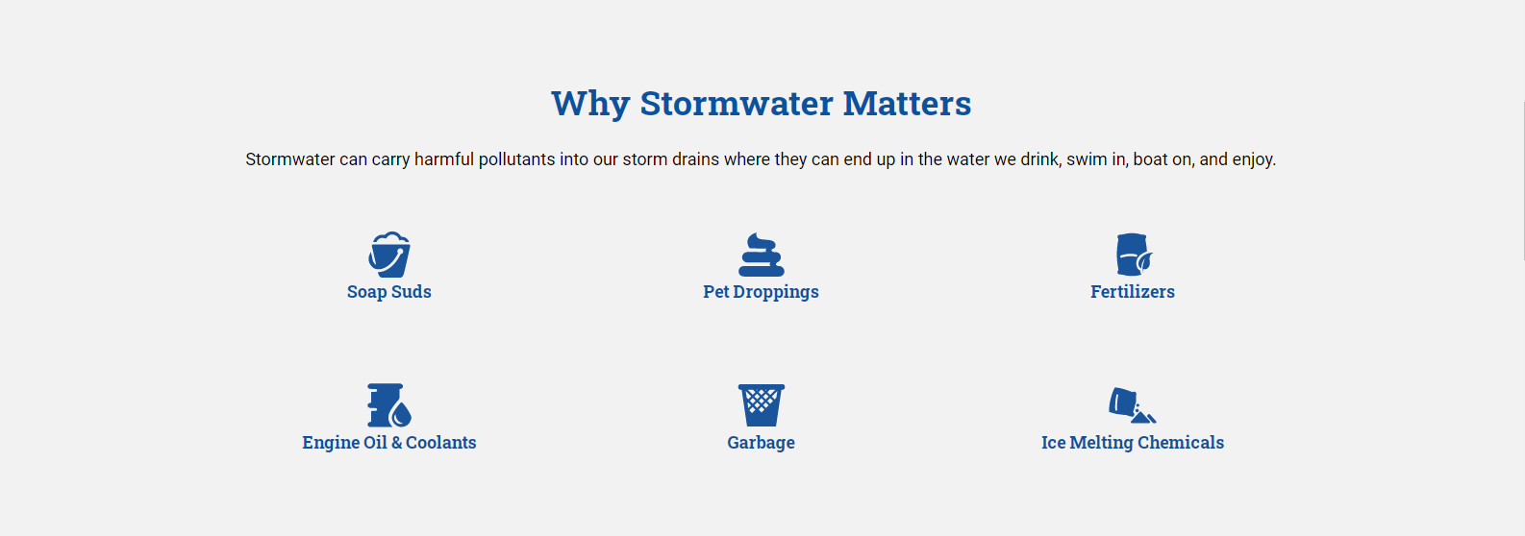
In 2021:
7,982 pages views.
Top Channels
Direct
Social
Organic search
Display
Referral
2020 → 2021
3,997 more users.
4,744 more sessions.
6,894 more pages views.

Slide 7
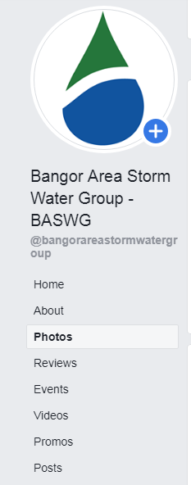
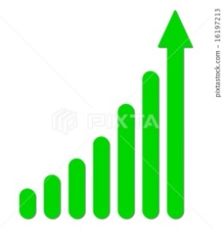
Continuing Social Media January 1, 2021 - December 31, 2021
Though the Facebook account has historically been BASWG's primary social account, Twitter and Instagram have seen a high growth over the year in follower counts. Impressions significantly increased, in addition to Post Link clicks.
BASWG social media pages saw growth of 1,279 total followers. A 7.1% increase between last year and this year.
Multi-year View 2018-2021:
Facebook: 579 →620 →684 → 698 → 719 (21 new followers since last year)
Twitter: 142 → 163 → 217 → 244 → 256 (12 new followers since last year)
Instagram: 133 → 197 → 239 → 262 → 304 (42 new followers since last year)
The BASWG Facebook had 145 posts, the BASWG Twitter account had 138 posts each, and the Instagram account had 83 posts.
Total reach:
155,500 → 223,000 → 192,454 →825,944 impressions
Engagement across all three platforms:
2,298 -> 17,200 → 8,295 →10,308 engagements
While Facebook's audience is mostly local, Twitter is national, with many of the highest-impression posts being shared by stormwater organizations nationwide.

Slide 8
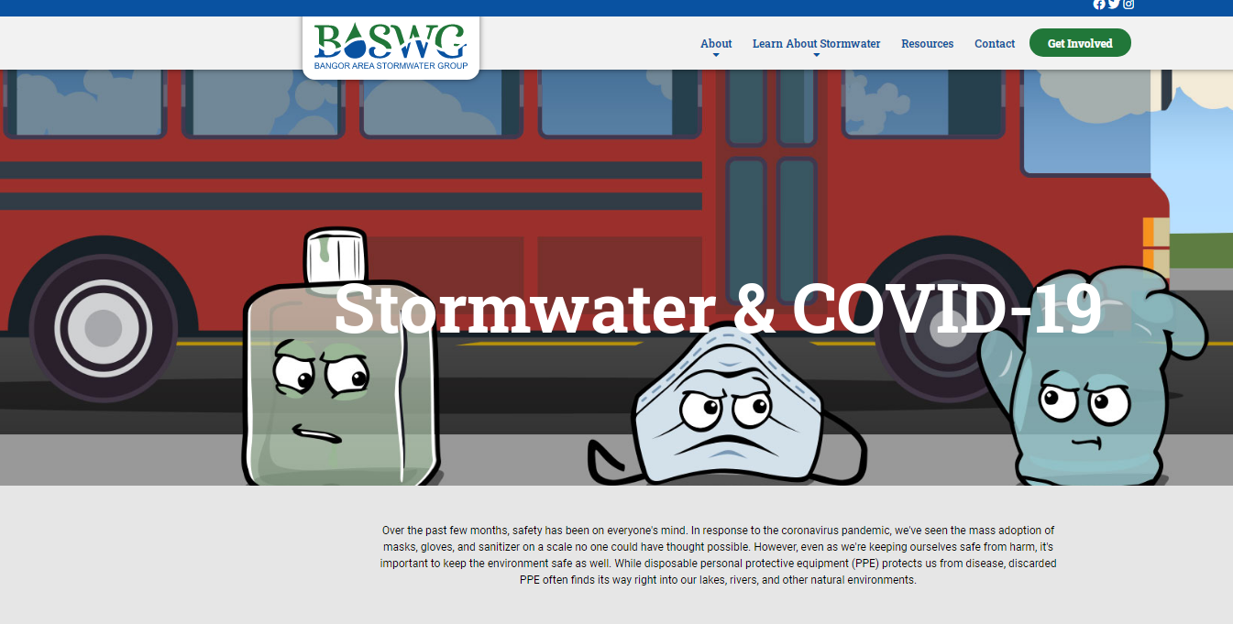
Online Outreach on Emerging Source of Stormwater Pollution
Personal Protection Equipment (PPE) Pollution
DEP approved

Slide 9
Spring 2021 PPE Campaign Reach
Spring
May 10, 2021- May 31, 2021
136,187 impressions
116 clicks, with .09% clickthrough
Summer
June 25, 2021- July 16, 2021
275,316 impressions
446 clicks, with .13% clickthrough
2021
November 24, 2021- December 31, 2021
193,759 impressions
271 clicks, with .13% clickthrough
User is directed to PPE landing page on the BASWG.org website as well as the Learn About Stormwater page.
Tech Talk:
Impressions = Number of times an ad was displayed on a viewer's screen
Clickthrough % = The percentage of clicks that an internet advertisement receives to page views of the advertisement

Slide 10
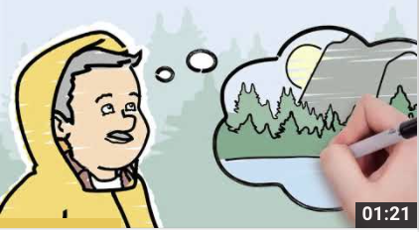
January 2022 Preroll Campaign Reach
2022
January 5, 2022 - January 31, 2022
144,795 impressions
194 clicks, with .13% clickthrough
Directs to BASWG.org homepage.
Tech Talk:
Impressions = Number of times an ad was displayed on a viewer's screen
Clickthrough % = The percentage of clicks that an internet advertisement receives to page views of the advertisement

Slide 11
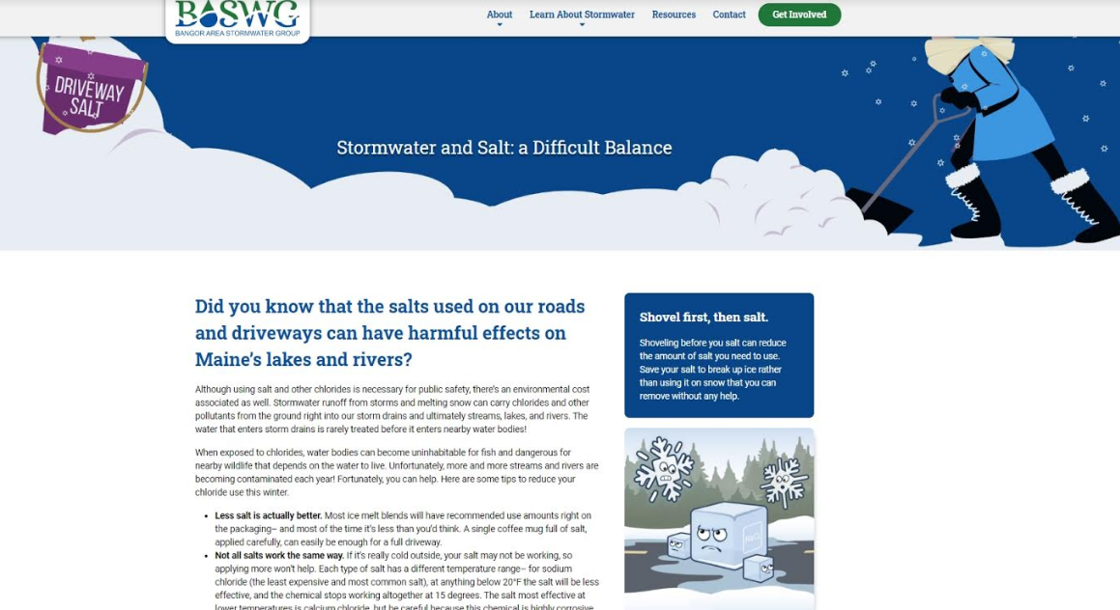
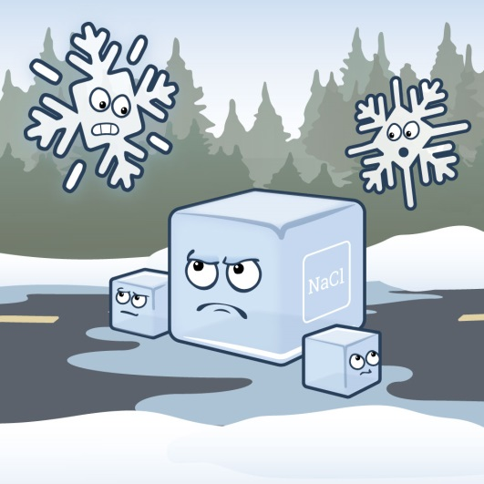
Online Winter Outreach Initiative Third Year – Targeted Online Display Ads

Slide 12
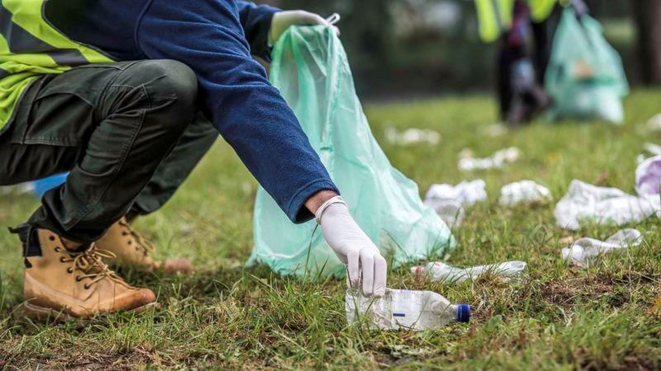
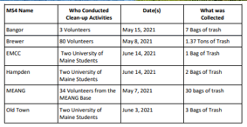
Street and Stream Clean-ups

Slide 13
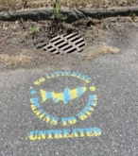
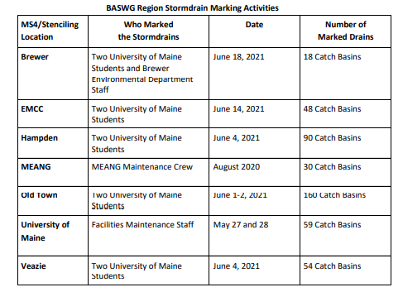

Slide 14
2021 Year-in-Review Permit Renewal – Continued Dialogue, Stakeholder Engagement and Formal Comment Letters
5-Year BASWG SWMP
Approved by DEP
2022-2027
Attended statewide stakeholder meetings
Engaged DEP in ongoing regional discussion
Jointly reviewed additional draft permit documents
Submitted comments as appropriate

Slide 15
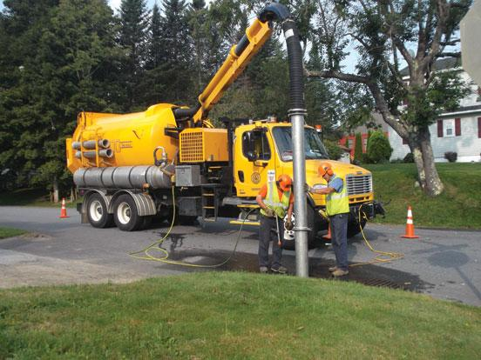
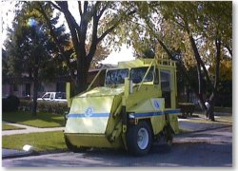
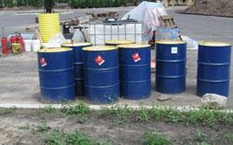
Regional Discussion/Coordination on Other MCMs Not in Plan, Not Required
Continued to share about audits, issues and innovations
Planning for trainings
Shared learning

Slide 16
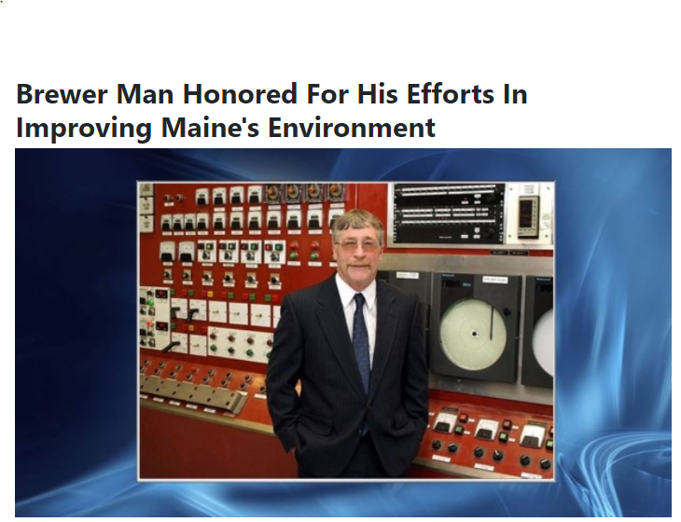
In Loving Memory of Ken Locke

Slide 18
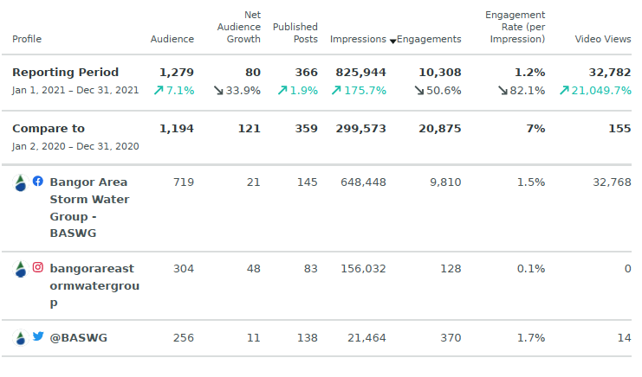
Continuing Social Media January 1, 2021 - December 31, 2021

Slide 19
Spring 2021 PPE Campaign Reach

Slide 20
Summer 2021 Campaign Reach

Slide 21
Winter 2021 PPE Campaign Reach

